Slide 1
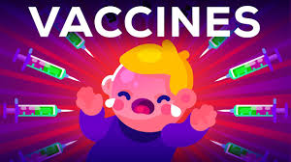
Vaccines

Slide 2
Vaccines
Vaccines are preparations of dead or weakened pathogens, or their products, that when introduced into the body, stimulate the production of protective antibodies or T cells without causing the disease
The name ‘vaccine’ comes from the Latin vacca (for cow). The earliest vaccination was done using the cow pox virus (which causes the disease in cow) as a vaccine against small pox in humans.
The English physician, Edward Jenner carried out the above vaccination in the late 18th century .

Slide 4
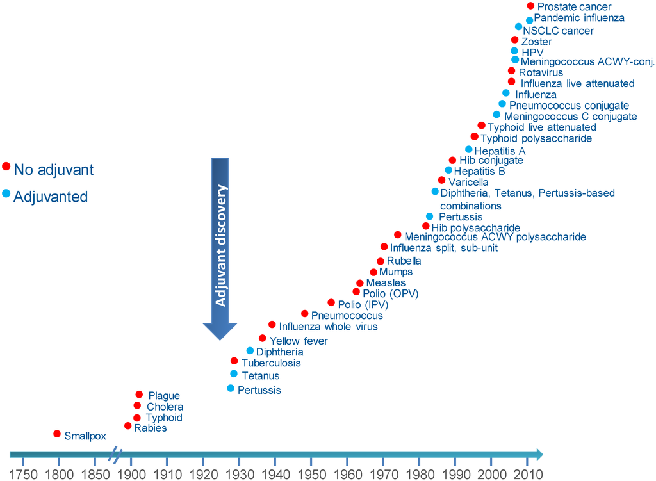
Vaccines evolution

Slide 5
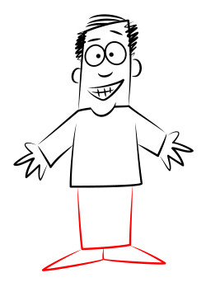

Slide 6
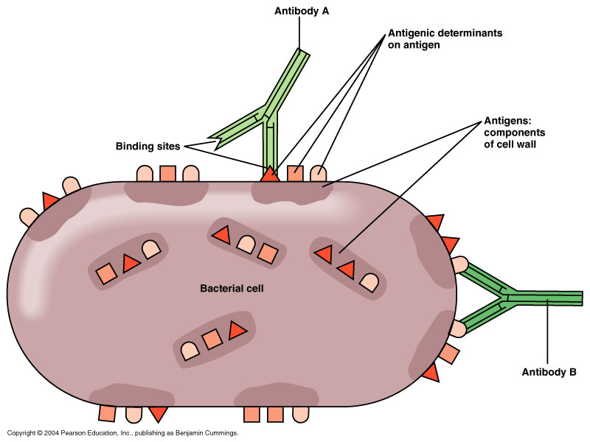
Antigens and epitopes

Slide 7
Traditional vaccines
Traditional vaccines can be classified into four broad groups:
Live attenuated bacteria/virus
Dead or inactivated bacteria/virus
Toxoids
Pathogen- derived antigens

Slide 8
Traditional vaccines Live attenuated
Attenuation is the process of weakening or reducing the virulence of a microorganism by using empirical procedures like prolonged storage and cultivation under suboptimal conditions (passaging).
Viruses are also attenuated in appropriate animal cell culture systems for many generations under a stressful environment
Advantages:
Low cost of preparation
The ability to elicit the desired immunological response in a single-dose application.
Disadvantages:
The potential to revert and become virulent
Limited shelf life.

Slide 9
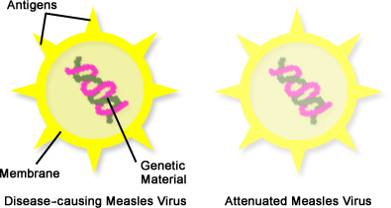
Traditional vaccines Live attenuated

Slide 10
Traditional vaccines Live attenuated

Slide 11
Traditional vaccines Dead, Inactivated Vaccines
Consist of suspensions of fully virulent organisms killed as mildly as possible in order not to destroy the antigenic determinants on the organism.
Killing can be achieved:
Heat (usually about 60°C for 1 hour)
Chemicals (phenol, alcohol, formalin, b-propiolactone)
Ultraviolet irradiation
Advantages:
No chances of reversal into a virulent strain
Relatively stable shelf life.
Disadvantages:
The higher cost of vaccine development
The possibility of reduced immune

Slide 12
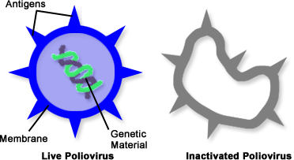
Traditional vaccines Dead, Inactivated Vaccines

Slide 13
Traditional vaccines Toxoids
A toxoid is derived from the treatment of active toxin produced by the bacterium with formaldehyde
Two commonly toxoid-based vaccine preparations are tetanus and diphtheria vaccines.
Tetanus toxin is produced by Clostridium tetani and diphtheria toxin from Corynebacterium diphtheriae which is also used as a toxoid for the treatment of whooping cough.

Slide 14
Traditional vaccines Pathogen-Derived Antigens
The pathogen-derived antigens comprise of antigenic portions of the pathogens which are generally surface derived, most commonly surface polysaccharides
The antigenicity of surface polysaccharides can be improved by conjugating them with a protein-based antigen.
Haemophilus influenzae capsular polysaccharide has been conjugated with diphtheria toxoid or the outer membrane protein of Neisseria meningitides.

Slide 15
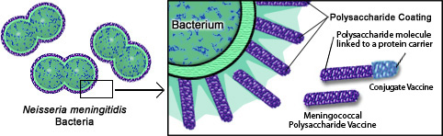
Traditional vaccines Pathogen-Derived Antigens

Slide 16
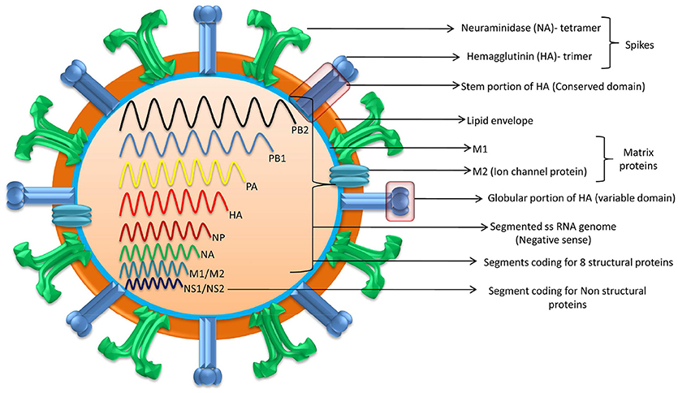
A comprehensive review of antigens on the equine influenza virus

Slide 18
Modern vaccines
The modern vaccines can be classified as
Subunit
DNA-based recombinant
Peptide vaccines

Slide 19
Modern vaccines
Subunit vaccines
Subunit vaccines comprise of a part of a bacteria or virus which can best stimulate the immune systems without rendering the person susceptible to the disease.
The subunits generally comprise of envelope proteins and anti- genic surface proteins.
There are two methods of developing a subunit vaccine:
To grow the bacteria in the laboratory and then break apart to recover and purify the desired antigens
By using recombinant DNA technology clone and express the antigenic moiety in a non-pathogen, generally referred to as recombinant subunit vaccine.

Slide 20
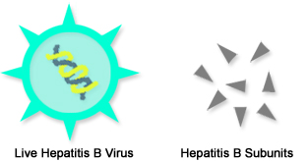
Modern vaccines
Subunit vaccines

Slide 21
Modern vaccines
Subunit vaccines

Slide 22
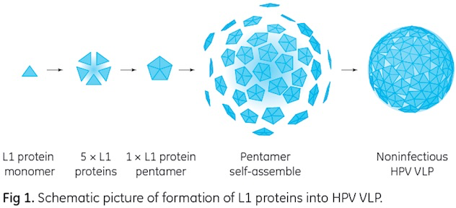
Modern vaccines
Subunit vaccines
Virus-Like Particles (VLPs)
Virus-like particles are basically viral structural proteins that are expressed in cells and possess native conformational epitope.
VLPs do not contain the genome and therefore cannot spread infection.
VLPs have the capacity to spread both cellular and humoral responses. Both Recombivax and Engerix-B were first vaccines to contain virus-like particles.

Slide 23
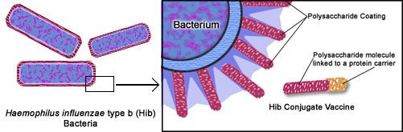
Modern vaccines
Subunit vaccines
Conjugate Vaccines

Slide 24
Recombinant vaccines
The recombinant vaccines basically comprise of:
Live genetically modified organisms
Recombinant (Genetic) vaccines

Slide 25
Recombinant vaccines
Live Genetically Modified Organisms
Bacteria or viruses with one or more deleted or inactivated genes or else could be vaccines carrying a gene from other disease agents which are referred to as vaccine vectors.
Two (double knockout) or more genes are deleted or inactivated so that the vaccine remains stable and does not revert back into a pathogenic state.
This type of vaccine development requires knowledge about the gene(s) responsible for the pathogenicity of the organism and assumes that those genes are not the same genes governing viability and the ability of the modified organism to induce an immune response.

Slide 26
Recombinant vaccines
Genetic or DNA Vaccines
The recombinant vaccines only comprise of the DNA.
DNA vaccines consist of circular pieces of DNA called the plasmids which contain a foreign gene from the disease- causing agent and a promoter which is helpful in expressing that gene as a protein in the target animal
Bird flu DNA vaccine was approved in June 2006, and subsequently a veterinary vaccine for horses to prevent the West Nile virus was approved in 2007.
The use of DNA vaccines for humans is in various stages of development for targets such as HIV, cancer and multiple sclerosis

Slide 27
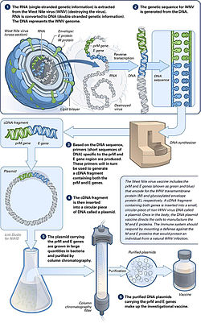

Slide 28
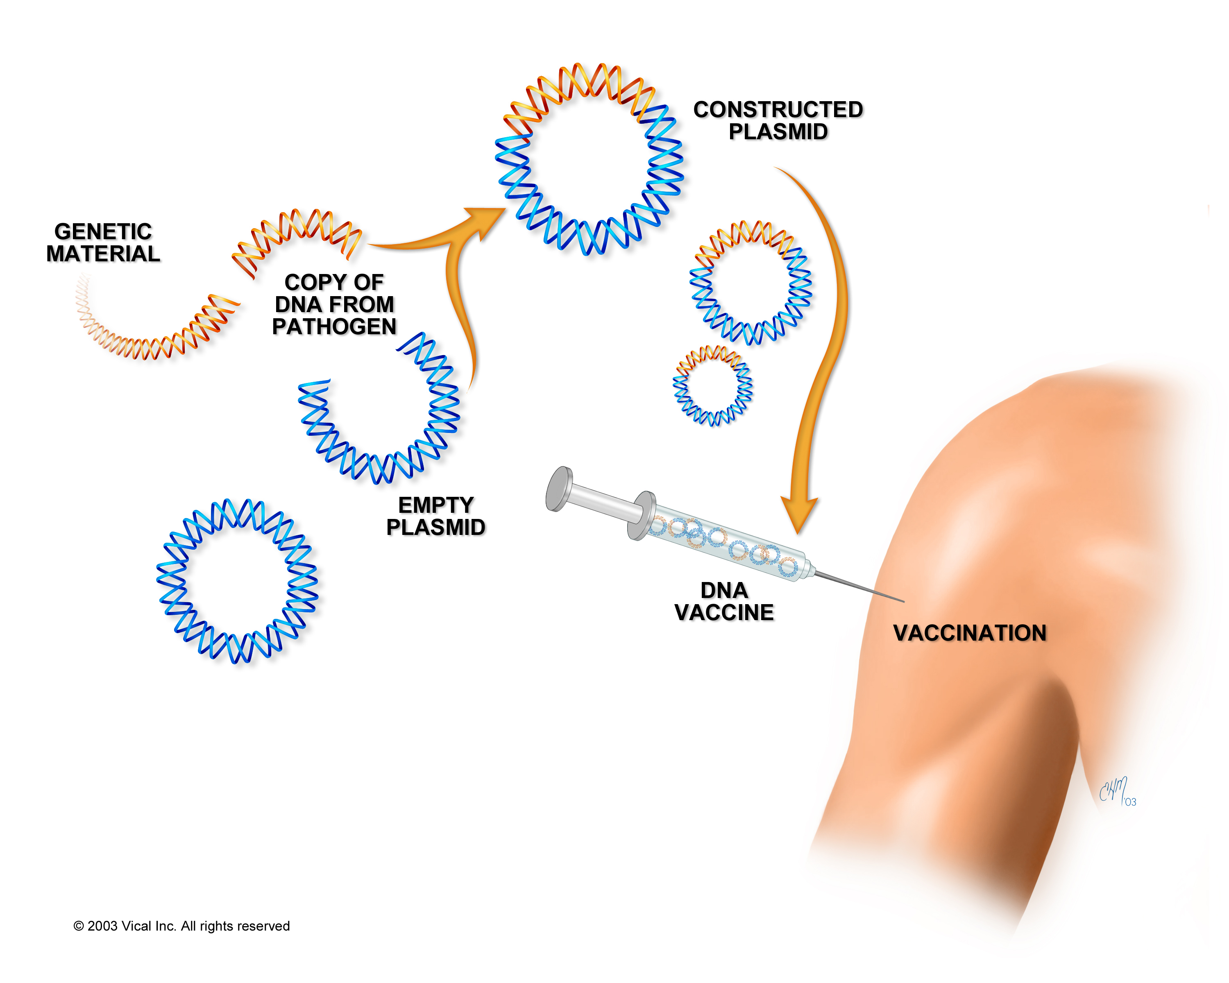
Recombinant vaccines
Genetic or DNA Vaccines

Slide 29
Peptide Vaccines
Chemically synthesized peptides comprising of 8–24 amino acids.
As compared to proteins, these are relatively small and have been referred to as peptidomimetic vaccines as they mimic the epitopes.
Complex structures of cyclic components, branched chains or other configurations can be built into the peptide chain, and thus with these kind of conformations, they mimic the epitopes
A critical aspect of peptide vaccines is to produce 3D structures similar to the native epitopes of the pathogen.

